Slide 1
Chapter 11: Trigonometric Identities and Equations
11.1 Trigonometric Identities
11.2 Addition and Subtraction Formulas
11.3 Double-Angle, Half-Angle, and Product-Sum Formulas
11.4 Inverse Trigonometric Functions
11.5 Trigonometric Equations

Slide 2
11.3 Double-Angle, Half-Angle, and Product-Sum Formulas
Double-Angle Identities
E.g. cos 2A = cos(A + A)
= cos A cos A – sin A sin A
= cos² A – sin² A
Other forms for cos 2A are obtained by substituting either cos² A = 1 – sin² A or sin² A = 1 – cos² A to get
cos 2A = 1 – 2 sin² A or cos 2A = 2 cos² A – 1.

Slide 3
11.3 Finding Function Values of 2θ
Example Given and sin θ < 0, find a) sin 2θ,
b) cos 2θ, and c) tan 2θ.
Solution To find sin 2θ, we must find sin θ.
Choose the negative square root since sin θ < 0.

Slide 4
So is…
None of the above

Slide 5
11.3 Finding Function Values of 2θ

Slide 6
11.3 Simplifying Expressions Using Double-Number Identities
Example Simplify each expression.
cos² 7x – sin² 7x (b) sin 15° cos 15°
Solution
cos 2A = cos² A – sin² A. Substituting 7x in for A gives cos² 7x – sin² 7x = cos 2(7x) = cos 14x.
Apply sin 2A = 2 sin A cos A directly.

Slide 7
11.3 Product-to-Sum Identities
Product-to-sum identities are used in calculus to find integrals of functions that are products of trigonometric functions.
Adding identities for cos(A + B) and cos(A – B) gives

Slide 8
11.3 Product-to-Sum Identities
Similarly, subtracting and adding the sum and difference identities of sine and cosine, we may derive the identities in the following table.
Product-to-Sum Identities

Slide 9
11.3 Using a Product-to-Sum Identity
Example Rewrite cos 2θ sin θ as the sum or difference of two functions.
Solution By the identity for cos A sin A, with 2θ = A
and θ = B,

Slide 10
11.3 Sum-to-Product Identities
From the previous identities, we can derive another group of identities that are used to rewrite sums of trigonometric functions as products.
Sum-to-Product Identities

Slide 11
11.3 Using a Sum-to-Product Identity
Example Write sin 2γ – sin 4γ as a product of two
functions.
Solution Use the identity for sin A – sin B, with 2γ = A and 4γ = B.

Slide 12
11.3 Half-Number Identities
Half-angle identities for sine and cosine are used in calculus when eliminating the xy-term from an equation of the form Ax² + Bxy + Cy² + Dx + Ey + F = 0, so the type of conic it represents can be determined.
From the alternative forms of the identity for cos 2A, we can derive three additional identities, e.g.
Choose the sign ± depending on the quadrant of the angle A/2.

Slide 13
11.3 Half-Number Identities
Half-Number Identities

Slide 14
11.3 Using a Half-Number Identity to Find an Exact Value
Example Find the exact value of
Solution

Slide 15
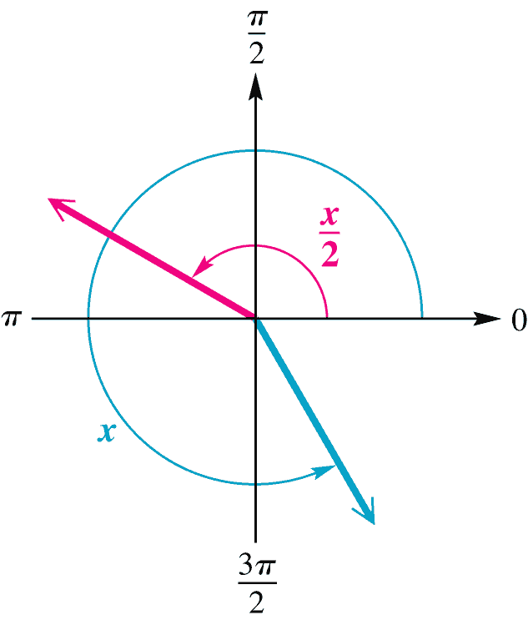
11.3 Finding Function Values of x/2
Example Given
Solution The half-angle terminates in quadrant II since

